Slide 1
Magnum Shooter
Team 6
Giovanni Aguilar
Gerardo Aguilera
Alex Flores

Slide 2
Genre
Top down endless survival shooter.

Slide 3
Game Mechanics
One gun and unlimited ammo.
Endless enemies with increasing difficulty. They will keep spawning so you need to kill them quick enough.
Large playable area with full movement freedom.
There are two enemy character types and one player type.

Slide 4
Game Play
Fight you're way out of this nightmare, will you survive?
It’s a simple game where the only challenge is beat your last high score.

Slide 5
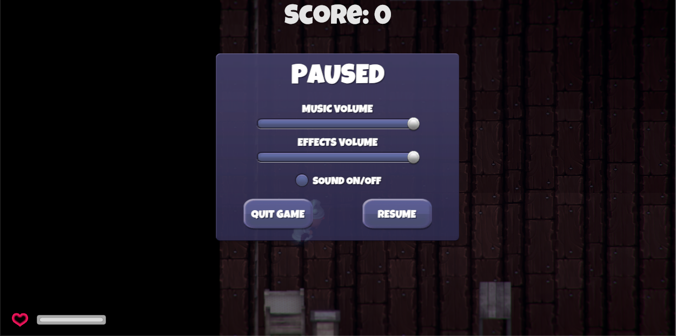
UI
Health bar and Score
Pause menu with options for

Slide 6
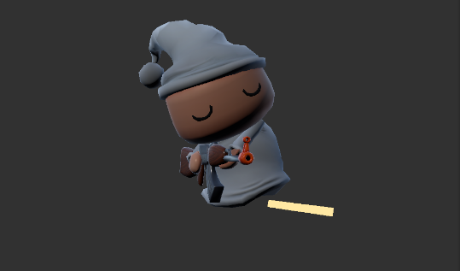
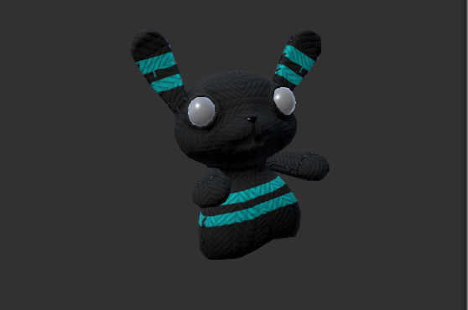
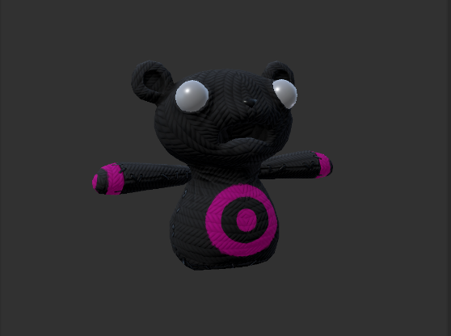
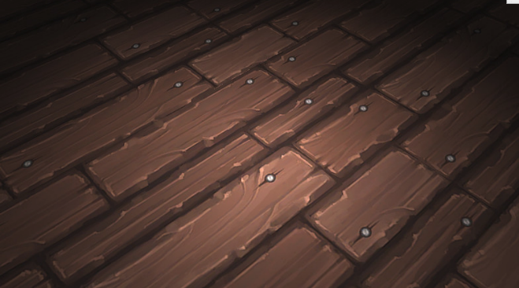
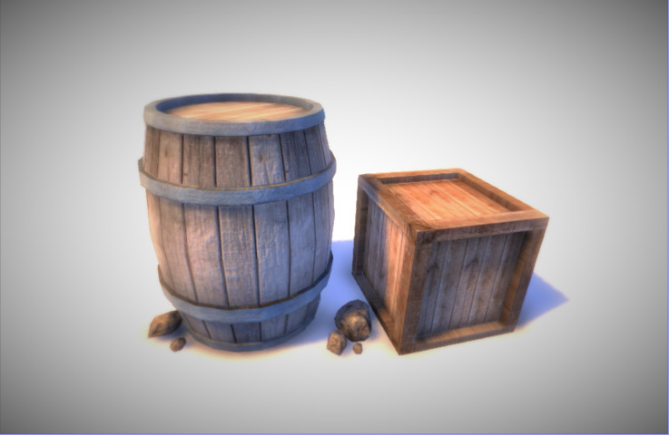
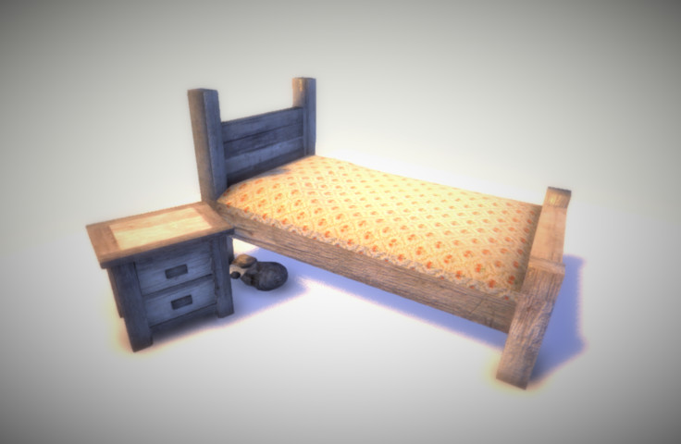
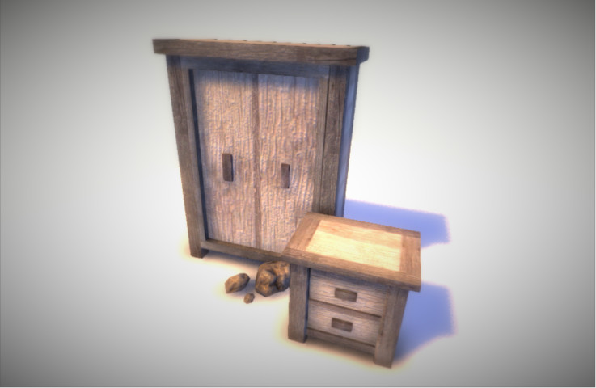
Art Assets
Art from the Unity Asset Store

Slide 7
Music
Dark Ambient loop by Ryuno: https://soundcloud.com/ryunocore

